Slide 1
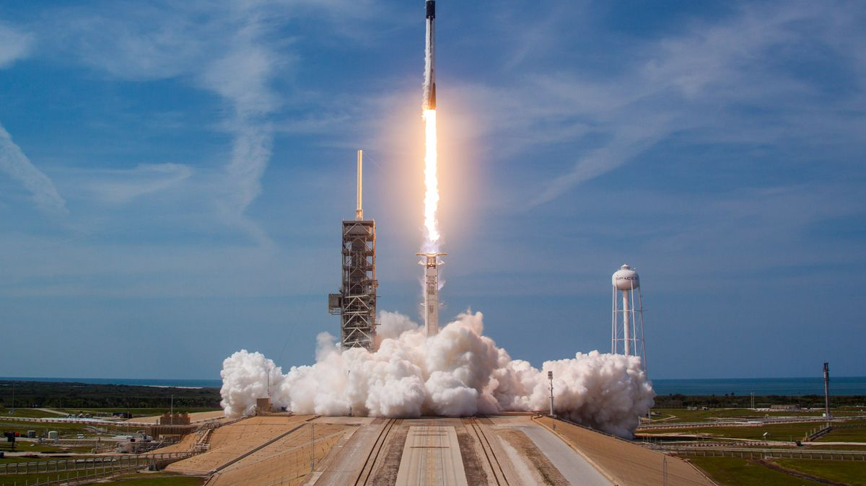
IBM Applied Data Science Capstone SpaceX Falcon 9 First Stage Landing Prediction
Presented by: Daniel Grillo
2021-10-15

Slide 2
Table of Contents
Executive Summary
Introduction
Methodology
Results
Discussion
Conclusion

Slide 3
Executive Summary
This applied data science capstone project attempts to predict if the SpaceX Falcon 9 first stage rocket launch will land successfully.
Several techniques were implemented in order to make predictions with the highest accuracy possible, some of these techniques being EDA (exploratory data analysis), web scrapping and data wrangling, visual analytics tools, and machine learning algorithms for predicting outcomes.

Slide 4
Introduction
The goal for this capstone project was to successfully predict the outcome of the SpaceX Falcon 9 first stage rocket launch to determine the probability of a successful rocket landing.
Considering the high costs of such procedures, utilizing data science to determine the landing outcome of a Falcon 9 rocket can significantly reduce the monetary costs for SpaceX.
The average cost of a Falcon 9 rocket launch is $62 million dollars, therefore if we can predict the landing outcome of a rocket launch before launching, this could benefit the people in charge of such operations.
How can we use data science to predict the landing outcome of SpaceX Falcon 9 rocket launches?

Slide 5
Methodology
Several labs were completed in order to obtain the data utilized throughout this entire capstone project, perform exploratory data analysis (EDA), better visualize information and relationships presented in the dataset, as well as determine the best machine learning algorithm and hyperparameters in order to make accurate predictions regarding the first stage rocket launch of SpaceX Falcon 9 rocket.
These labs are:
Data Collection Lab
Request and parse the SpaceX launch data using GET request
Turn this data into JSON format, to then be converted into a data frame
Filter the data to only include Falcon 9 launches
Handle missing values
Data Wrangling Lab
Calculate number of launches per site
Calculate number of occurrences per orbit
Calculate number and occurrence of mission outcome per orbit type
Create a landing outcome label from Outcome column

Slide 6
Methodology
EDA with Visualization Lab
Visualize the relationship between Flight Number and Launch Site
Visualize the relationship between Payload and Launch Site
Visualize the relationship between Success Rate of each Orbit Type
Visualize the relationship between Flight Number and Orbit Type
Visualize the relationship between Payload and Orbit Type
Visualize the Launch Success yearly trend
Machine Learning Predictions Lab
Standardize the data
Split the data into training data and testing data
Create a Logistic Regression object, SVM object, Decision Tree Classifier object, and a KNN object
Fit a GridSearchCV object to all these objects, and fit data to find best parameters

Slide 7
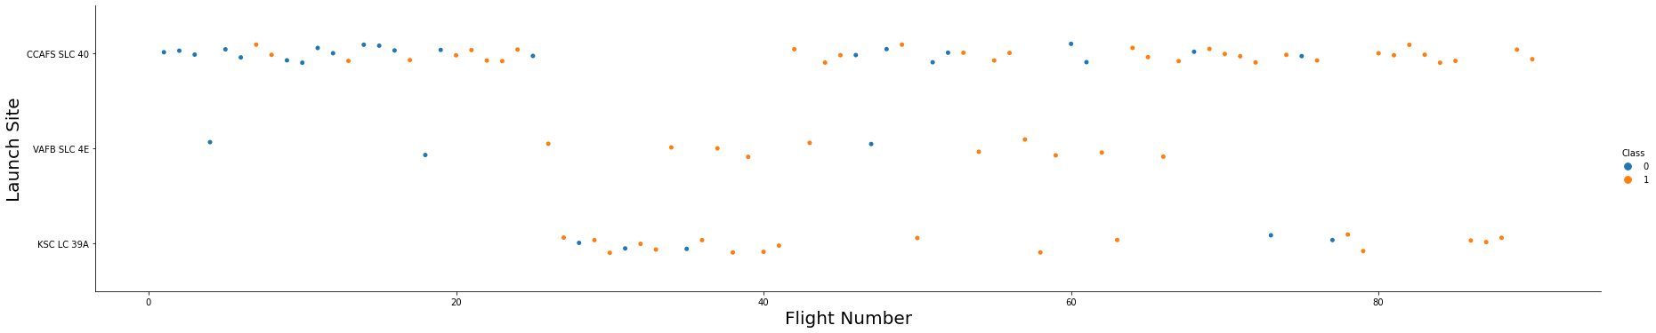
Results
We started this capstone project by requesting the rocket launch data from the SpaceX API, followed by converting this JSON data into a data frame for easier handling, and lastly, we filtered the data to the launches relevant to Falcon 9.
From the Exploratory Data Analysis with Visualization Lab, we obtained the following results:
Relationship between Flight Number and Launch Site

Slide 8
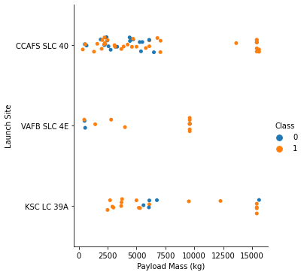
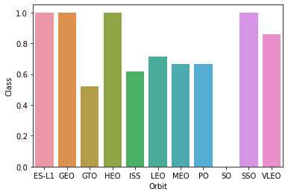
Results
Relationship between Payload and Launch Site
Relationship between Success Rate of each Orbit Type

Slide 9
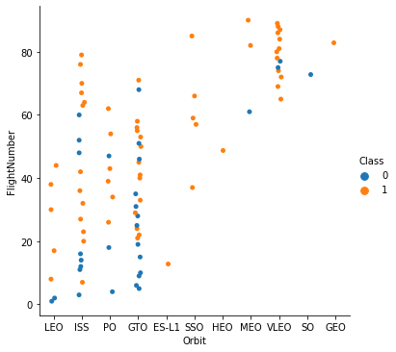
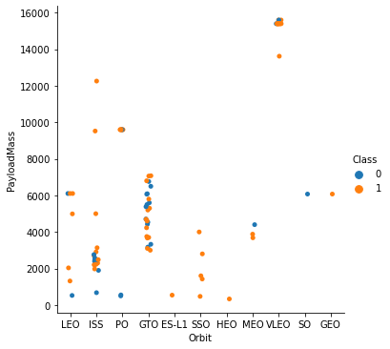
Results
Relationship between Flight Number and Orbit Type
Relationship between Payload and Orbit Type

Slide 10
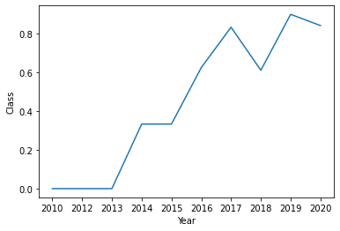
Results
Launch Success yearly trend visualization
From the Exploratory Data Analysis with SQL Lab, we obtained the following results:
[‘CCAFS LC-40’, ‘VAFB SLC-4E’, ‘KSC LC-39A’, ‘CCAFS SLC-40’]
Unique launch sites in space mission

Slide 11
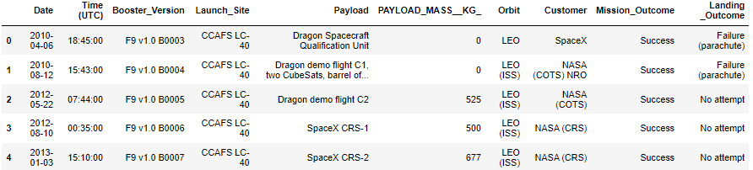
Results
5 records where launch sites begin with the string ‘CCA
45596 kg
Total payload mass carried by boosters launched by NASA (CRS)
2928.4 kg
Average payload mass carried by booster version F9 v1.1
2010-04-06 00:00:00
Date when first successful landing outcome in ground pad was achieved

Slide 12
Results
[‘F9 FT B1022’, ‘F9 FT B1026’, ‘F9 FT B1021.2’, ‘F9 FT B1031.2’]
Names of boosters which have success in drone ship and have payload greater than 4000kg, but less than 6000kg
Successful Mission Outcomes: 98
Failed Mission Outcomes: 1
Total number of successful and failure mission outcomes
[‘F9 B5 B1048.4’, ‘F9 B5 B1049.4’, ‘F9 B5 B1051.3’, ‘F9 B5 B1056.4’, ‘F9 B5 B1048.5’, ‘F9 B5 B1051.4’, ‘F9 B5 B1049.5’, ‘F9 B5 B1060.2’, ‘F9 B5 B1058.3’, ‘F9 B5 B1051.6’, ‘F9 B5 B1060.3’, ‘F9 B5 B1049.7’]
Names of the booster versions which have carried maximum payload mass

Slide 13

Results
Booster versions and launch sites for failed landing outcomes in drone ship, for 2015
No attempt: 10
Failure (drone ship): 5
Success (drone ship): 5
Success (ground pad): 3
Controlled (ocean): 3
Uncontrolled (ocean): 2
Failure (parachute): 2
Precluded: 1
Count of landing outcomes between 2010-06-04 and 2017-03-20, in descending order

Slide 14
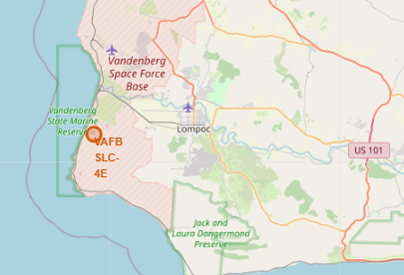
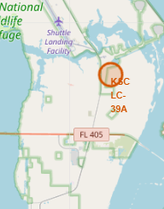
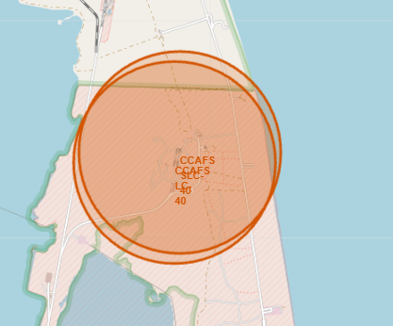
Results
From the Launch Sites Location Analysis with Folium Lab, we obtained the following results:
Launch Sites Locations on Map

Slide 15
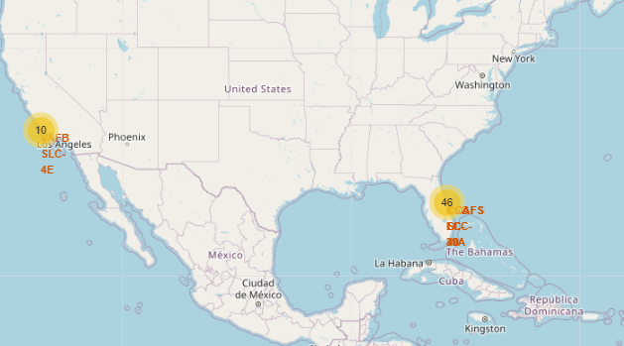
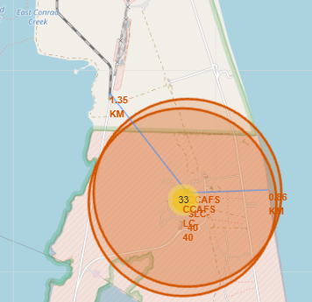
Results
All the successful/failed launches for each site
Distance to closest railroad and coastline

Slide 16
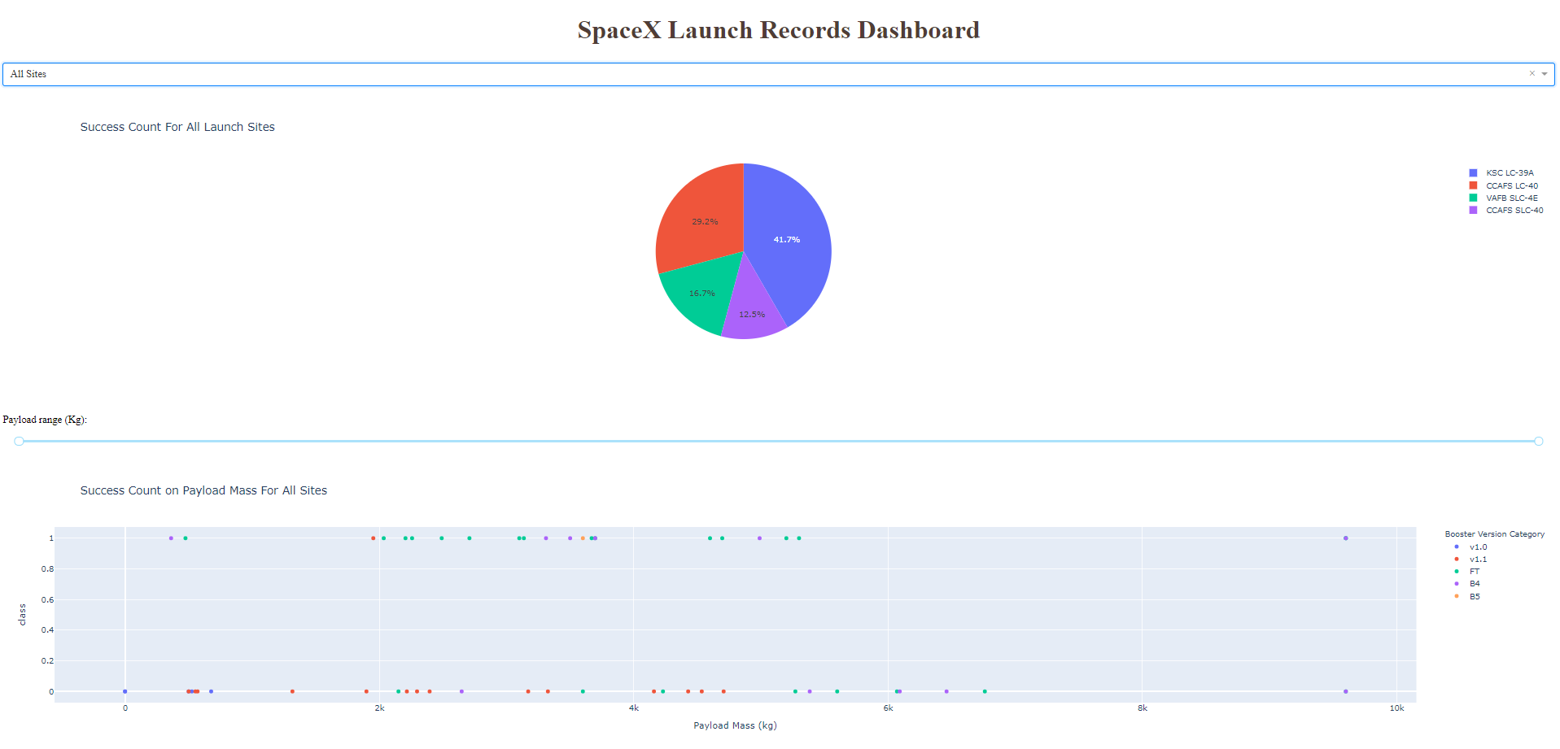
Results
From the Plotly Dash Dashboard Lab, we obtained the following results:
This in an interactive dashboard generated utilizing Dash and Plotly (Python libraries). It contains a dropdown menu at the top of the dashboard, which allows the user to select the specific launch site and view its statistics or choose to view all the launch sites and compare them. It contains a range slider at the bottom to change the payload amount carried during the launch, as well as a scatter plot showing the success rate based on the payload amount selected.

Slide 17
Results
From the SpaceX Falcon 9 First Stage Landing Prediction Lab, we obtained the following results:
 | Logistic Regression | Support Vector Machine | Decision Tree Classifier | K Nearest Neighbors
Training data accuracy | 0.84643 | 0.84821 | 0.88750 | 0.84821
Testing data accuracy | 0.83333 | 0.83333 | 0.55556 | 0.83333

Slide 18
Discussion
The data collection procedures were necessary to obtain the launch data from the SpaceX API, as well as the techniques utilized to transform the JSON data into a data frame for easier handling and visualization, and the filtering procedures to only work with the data relevant to the subject.
Data wrangling was a very important part of this project in order to analyze and better observe the trends within this data, this allowed noticing key factors that contribute to success/failure of Falcon 9 first stage rocket launch.
Creating visualizations is a great tool to better understand the data we are working with, in addition to graphically represent relationships between variables in the data set obtained.
Lastly, the different machine learning models used allowed us to see how different models perform predictions with the training and testing data, therefore we were able to choose the one with the highest overall accuracy to further predict the outcome of Falcon 9 first stage rocket launching.

Slide 19
Conclusion
This applied capstone project was a great learning experience to better understand the key characteristics of a data science project and how to tackle problems with a data scientist mentality.
The tools implemented in this capstone are very useful in several different ways, from collecting data necessary to find solutions to problems, filtering the data to use relevant information, to graphically represent the insights found on this data and output it in a graphical and user-friendly manner so that third parties can easily understand the relationships and key features observed.
The content in this course will be very useful when approaching different problems since this is a very detailed breakdown of a topic (Falcon 9 first stage rocket launching prediction), and how to use all the tools learned throughout the entire IBM Data Science Professional Certificate.

Slide 20
Thank you for your time

